Slide 1
Job Market Analysis
Name : Karunakaran R
Email id :rkarunakaranraja@gmail.com
Batch : 12th May CDA
Project id : PTID-CDA-SEP-25-722

Slide 2
Agenda
Introduction
Project Objectives
Dataset Description
Tools & Methodology
Python(EDA)
Tableau Dashboard
Insights
Recommendations
Conclusion

Slide 3
Introduction
To analyze job market trends across states, industries, and job titles.
To understand salary variations and skill demand.
I created dashboard for decision making.

Slide 4
Project Objectives
Identify states with most job opportunities.
Compare minimum vs maximum salaries.
Find top industries & companies hiring.
Highlight in-demand skills & top job titles.
Examine education vs salary

Slide 5
Dataset Description
My dataset is includes 742 rows and 42 features like Job title, Salary Estimate,
Job Description, Rating, Company, Location, Company, Headquarters.
And many more acquired from various sources.

Slide 6
Tools & Methodology
Python → Data extraction and for Cleaning the dataset.
Tableau → Dashboard & Visualization

Slide 7
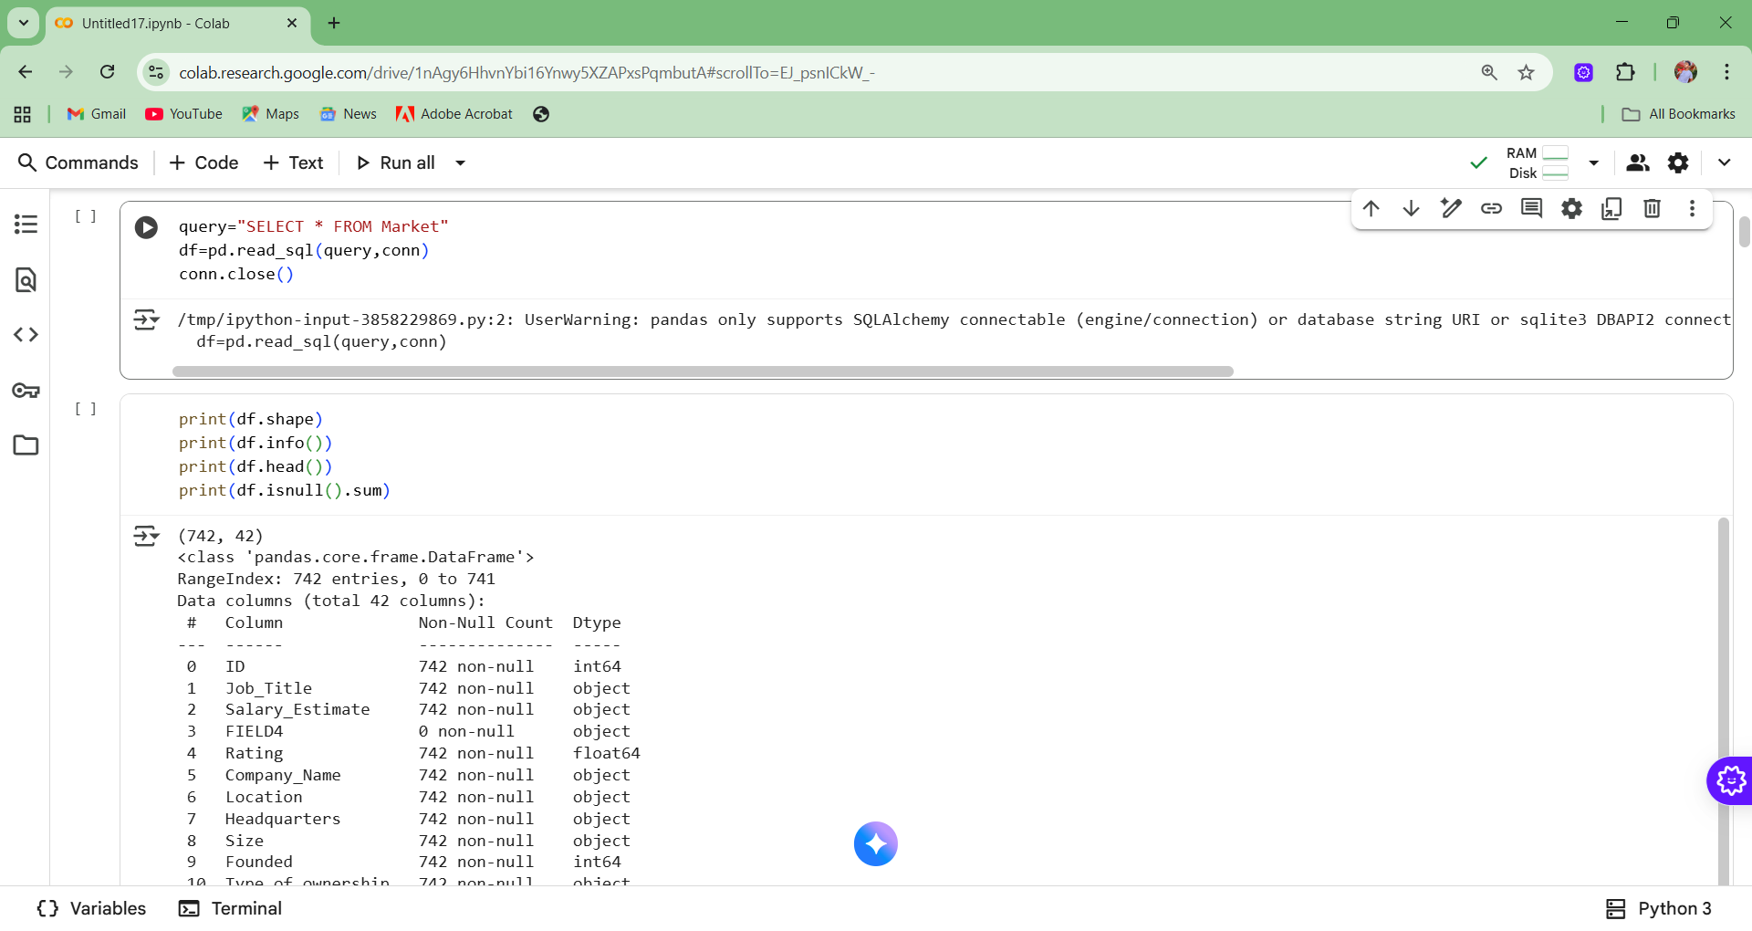
Python (EDA)

Slide 8
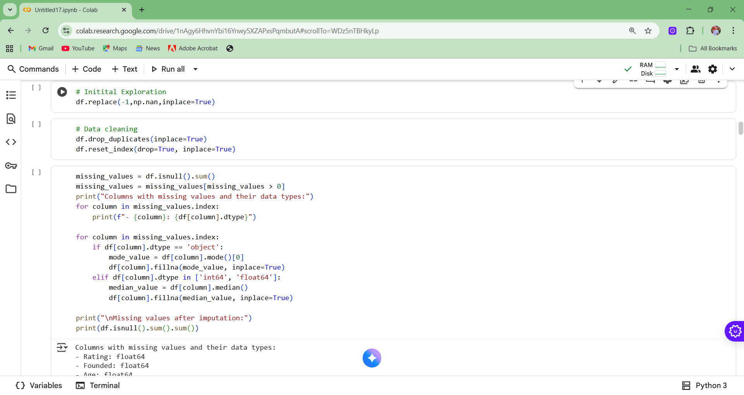

Slide 9
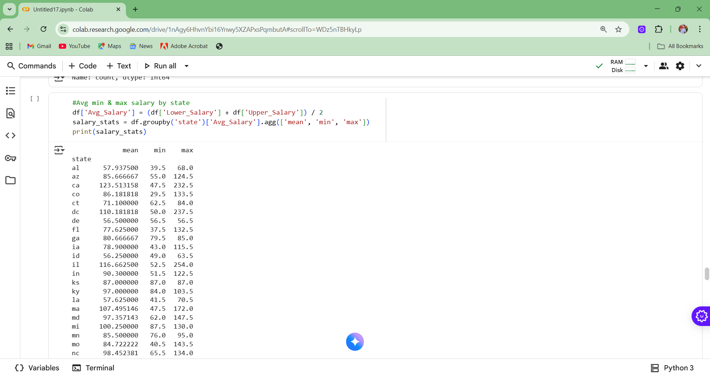

Slide 10
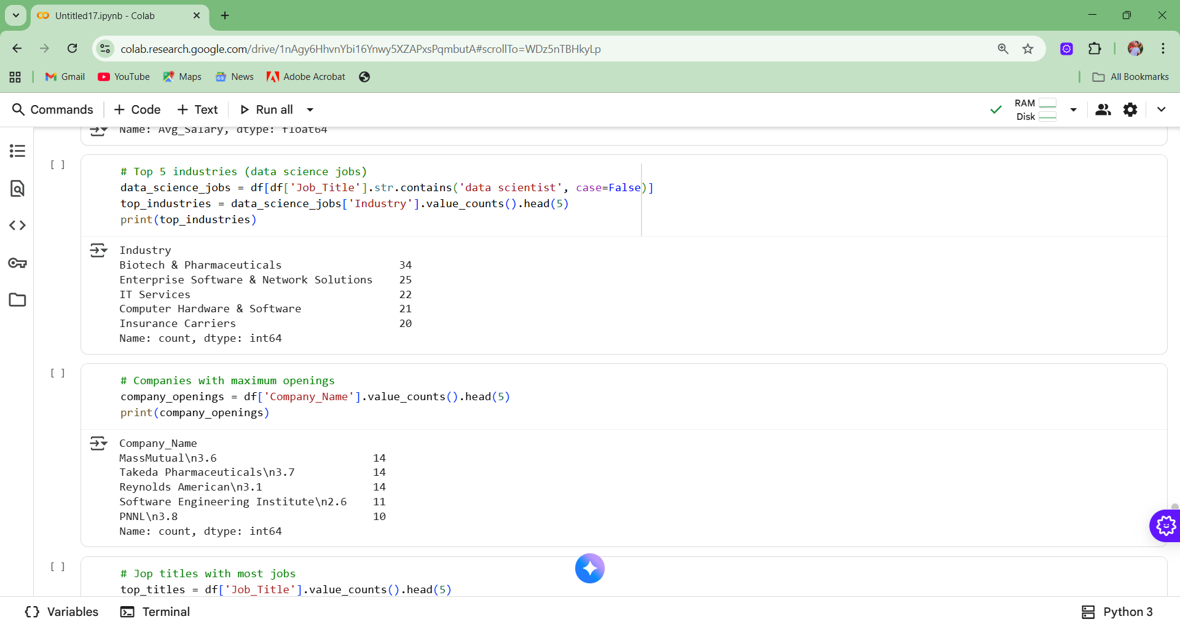

Slide 11
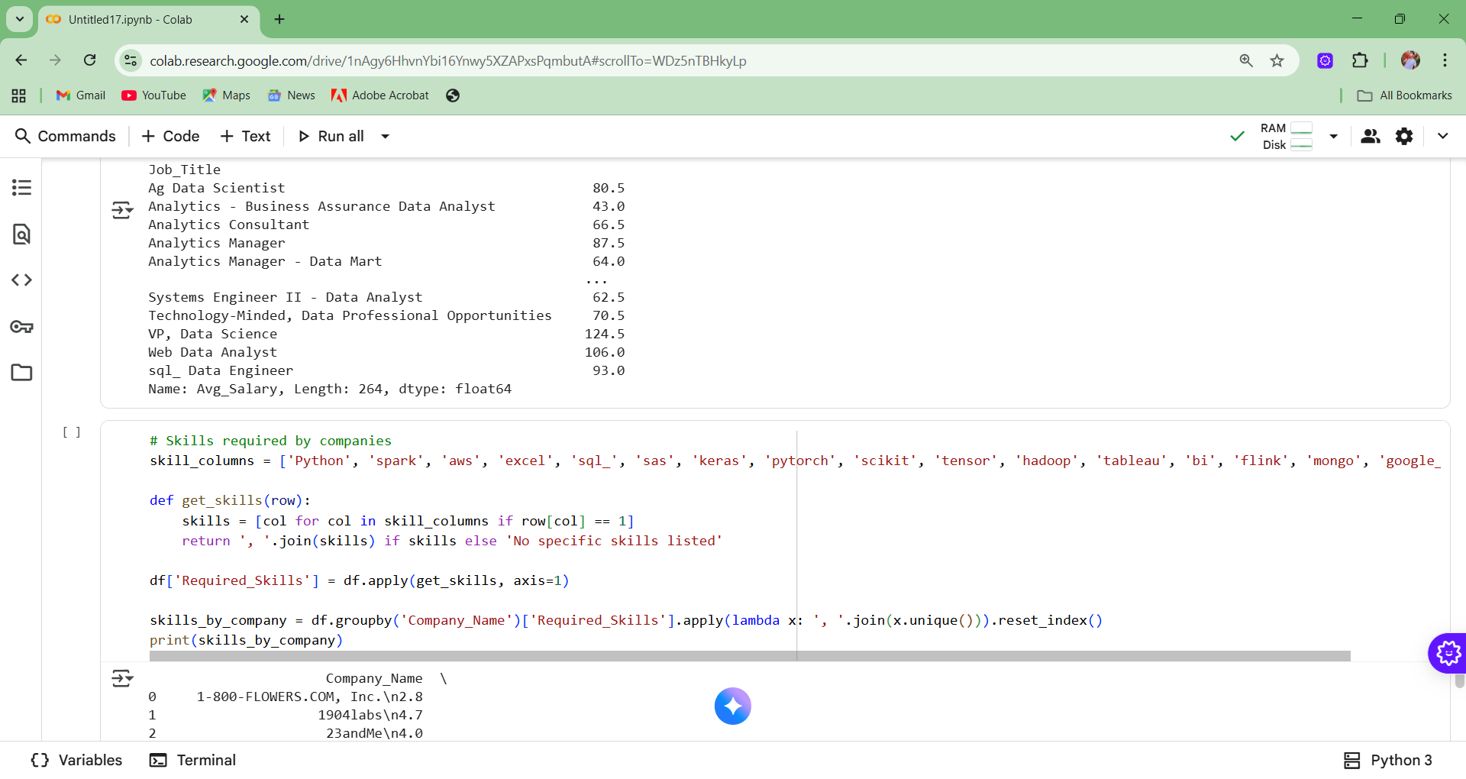

Slide 12
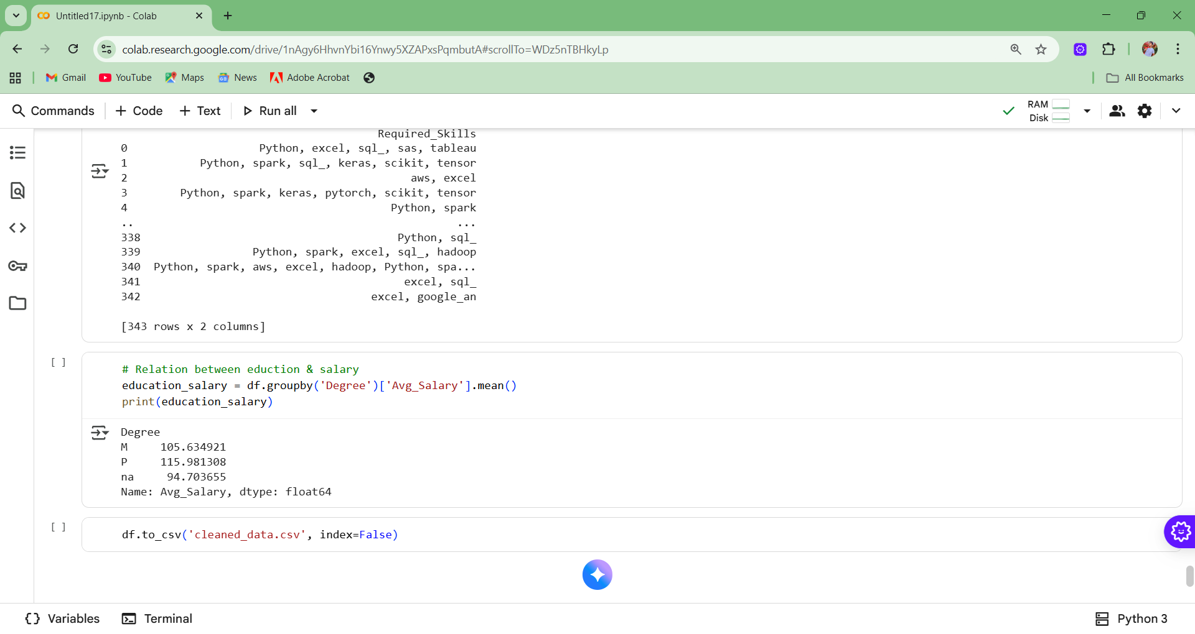

Slide 13
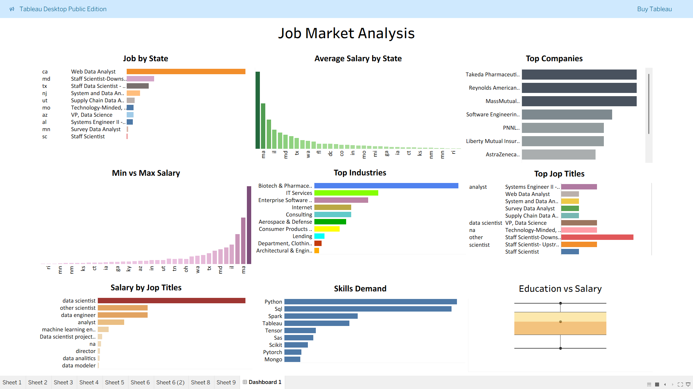
Tableau dashboard

Slide 14
Insights
California and Texas have the highest number of jobs.
Data Scientist, Analyst, and Software Engineer are top job titles.
Python, SQL, and Tableau are the most demanded skills.
Higher education levels lead to higher average salaries.

Slide 15
Recommendations
For Job Seekers: Focus on Python, SQL, Tableau; aim for industries like IT, Finance, Bio-tech.
For Companies: Recruit in high-demand states and invest in skill development.

Slide 16
Conclusion
Job market is highly competitive but skill-driven.
Data-driven insights help align career and hiring strategies.
Tableau dashboard provides a holistic view of opportunities.

Slide 17
Thank you

